Slide 1
IDENTIFYING
PNEUMONIA
By Nicole Crow, Cooper Kappeler, Jacob Booeshaghi, Julia Leser

Slide 2
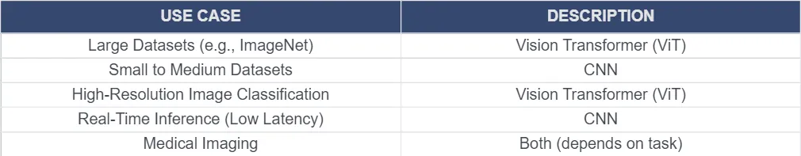
project overview
Using ViT to determine Pneumonia vs Normal X-Rays
Pre-Trained Hugging Face ViT
Customizing it on our dataset
We chose to use a ViT because it can operate on larger datasets and can look at the lungs in a global context which is more beneficial for identifying pneumonia in X Rays [8]
Creating a New Model
Testing with non training Chest X-Rays

Slide 3
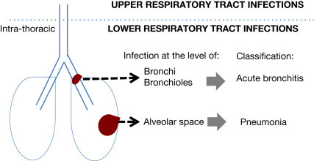
Problem: What is Pneumonia
Pneumonia is an infection of the alveolar space that causes severe inflammation and accumulation of fluid. This can be caused by either viruses, bacteria or fungi. [1]
Symptoms Include:
High Fever
Cough with yellow, green, or red mucus
Shortness of breath [2]
Diagnosis Criteria:
Blood Tests- testing for confirmed infection (High white blood cell count)
Chest X Ray- Gold standard for confirmation, determines extent of extent and location of infection
Septum Test: A Sample of fluid from lungs is taken to pinpoint the germ causing infection for more precise treatment [3]
Treatment:
Antibiotics- For Bacterial based Pneumonia
Cough Medicine: Loosens phlegm and moves fluid out of the lungs
Fever Reducers: Mainly for reducing pain in patients

Slide 4
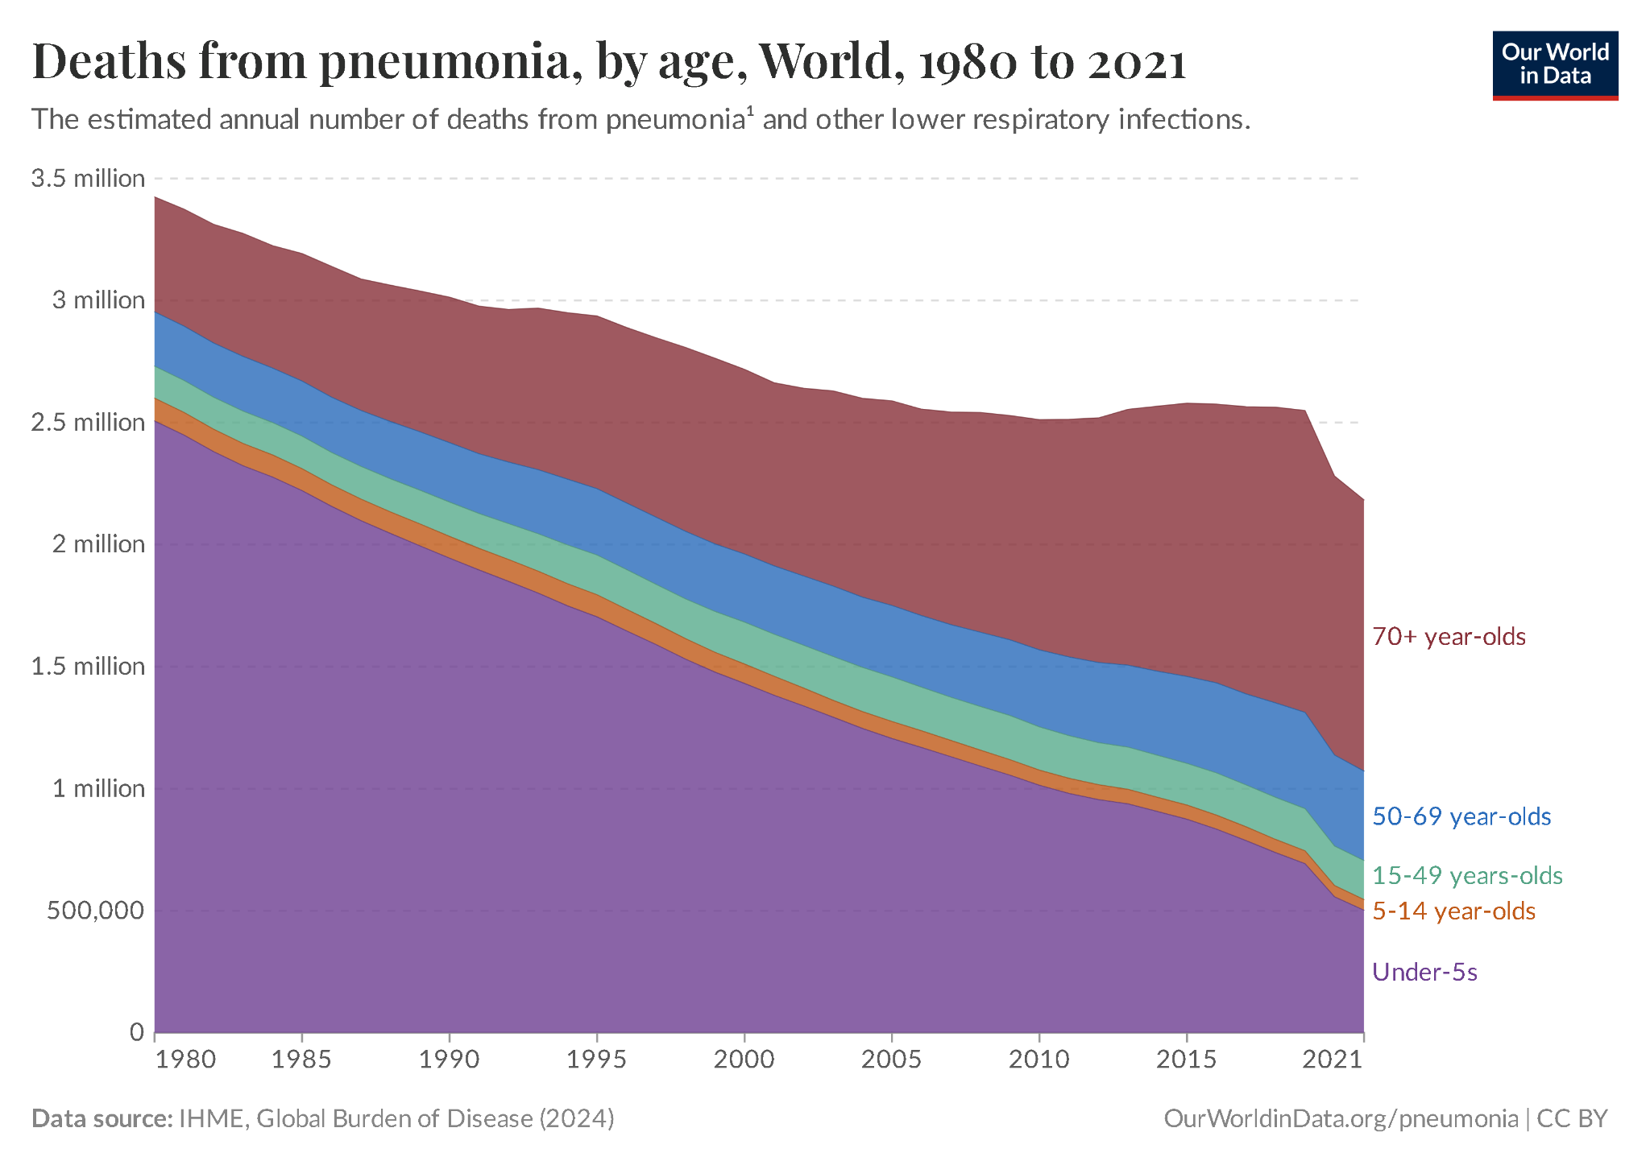
Significance
Incidence:
More than 10 million cases in the US alone
1 million hospitalizations in the US [4]
Financial Burden:
$7000 to manage one case of pneumonia inpatient [4]
$140,000 to manage in an outpatient setting [4]
$40,000 for Hospital-Acquired Pneumonia [4]
Chest X rays cost anywhere between $100-$1000. Increasing with each reiteration if not pneumonia not originally identified. [6]
Timeline:
Pneumonia can take days to get a diagnosis especially during times of outbreaks with lots of cases and limited doctor availability. [7] By introducing our system we can cut down time required and thus generate better patient outcomes.
[5]
Cases of Pneumonia in the world from 1980-2021 [5]

Slide 5
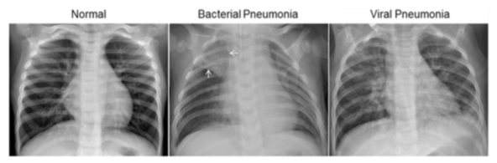
DATA
Sourced from a Kaggle Data set with 5,863 X-ray Images from pediatric patients of one to five years old from Guangzhou Women and Children’s Medical Center sorted into normal and pneumonia images. This data was then balanced to train on 1000 images from each source.
VS

Slide 6
Methodology ( Supervised Learning)
Steps:
Loading in the ViT,
Preparing data by labeling our X-Ray images and resizing them for the ViT
Balancing Data
Running the ViT
Training the ViT and fine tuning by running through a bunch of different images and giving a yes or a no
Save this model
Evaluate the model
Generates a confusion matrix
Attention Map Generation.
Steps Of ViT
1. Split → Chopping up each image
2. Describe → Taking notes on each image piece
3. Tag → Taking note of each piece location
4. Think→ Comparing all tiles to each other
5. Decide→ Is this normal or Pneumonia

Slide 7
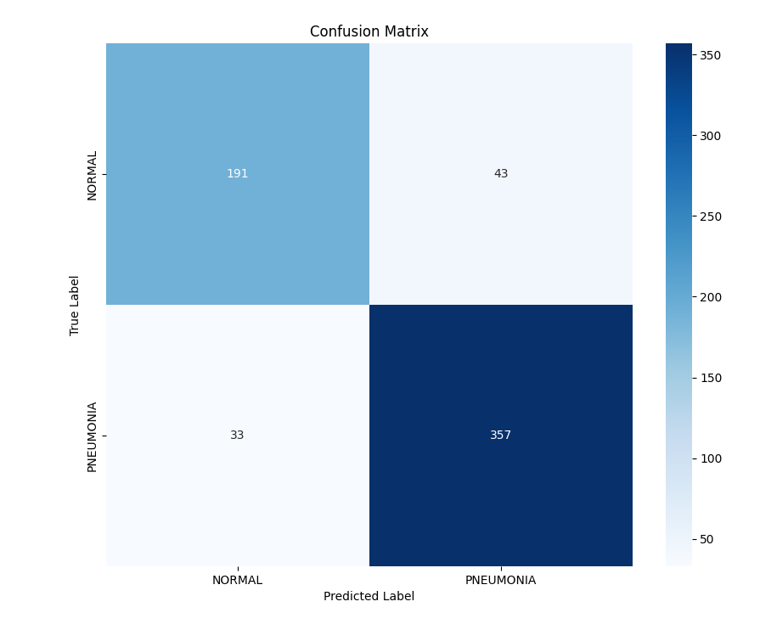
Results
Confusion Matrix:
A Matrix Table that can show the performance of our model by defining true positives, true negatives, false negatives, and false positives
Scores
Accuracy: 0.88
Precision: 0.89
Recall: 0.92
F1 Score: 0.90

Slide 8
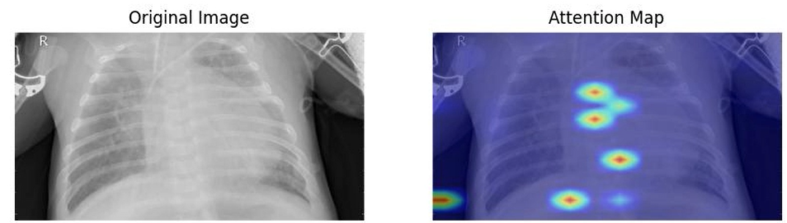
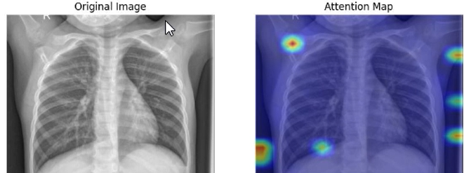
Results
Pneumonia
Normal
Attention Visualization
Heatmap of how importance weights of the different parts of the image and how much attention it is given by the model.
Our model tends to focus on areas within the lungs in Pneumonia patients and then outside of the lungs for normal patients. Identifying points of infection

Slide 9
Citation
[1] Lim, W. S. (2021). Pneumonia—Overview. Reference Module in Biomedical Sciences, 1(1), 185–197. https://doi.org/10.1016/b978-0-12-801238-3.11636-8
[2] Cleveland Clinic. (2022, November 15). Pneumonia: Symptoms, Treatment, Causes & Prevention. https://my.clevelandclinic.org/health/diseases/4471-pneumonia#symptoms-and-causes
[3] Mayo Clinic. (2020). Pneumonia - Diagnosis and treatment - Mayo Clinic. Mayoclinic.org. https://www.mayoclinic.org/diseases-conditions/pneumonia/diagnosis-treatment/drc-20354210
[4] Limper, A. H. (2012). Overview of Pneumonia. Goldman’s Cecil Medicine, 587–596. https://doi.org/10.1016/b978-1-4377-1604-7.00097-x
[5] Dadonaite, B., & Roser, M. (2019, November). Pneumonia. Our World in Data. https://ourworldindata.org/pneumonia
[6] Malka, T. (2022, April 5). How Much Does an X-ray Cost? With and Without Insurance. K Health. https://khealth.com/learn/healthcare/how-much-does-an-x-ray-cost/
[7] Kampfrath, T. (2021, November 5). Pneumonia Testing. Testing.com. https://www.testing.com/pneumonia-testing/
[8] Idrees, H. (2024, September 6). Vision Transformer vs. CNN: A Comparison of Two Image Processing Giants. Medium. https://medium.com/@hassaanidrees7/vision-transformer-vs-cnn-a-comparison-of-two-image-processing-giants-d6c85296f34f
‌
‌
‌
‌
‌
‌
‌

